Slide 1
Predictive Modelling Projects – Use Case: Customer Lifetime Value for Online Marketplace
Digital Vidya

Slide 2
Problem Statement
Stakeholders and their KPI
Expectations
Sales and Marketing – Olist :
Better visibility into Active and Inactive Customers
Meet YoY Growth targets by repeated purchases or new purchases
Better Targeted Marketing to get more revenue
Strategy – Olist : More visibility into customer behavior to define growth strategy
Sellers : Better visibility in demand for better planning
Creation of Analytical Engine to churn the existing data and produce reports on an interactive dashboard
Note: These are sample problem statements

Slide 3

Data Analysis - Overview
Database Overview
Important Tables for Customer Lifetime Value Analysis:
olist_customers_dataset – Unique Customers
olist_orders_dataset – Customer Orders
olist_order_payments_dataset – Payment Transactions
Customer Lifetime Value:
Recency | Frequency | Monetary Value
Business Outcomes – Benefits tied to KPI
Identifying Active and Inactive Customers
Forecasting valuable Individual Customers
Forecasting sales volume for Customer base

Slide 4
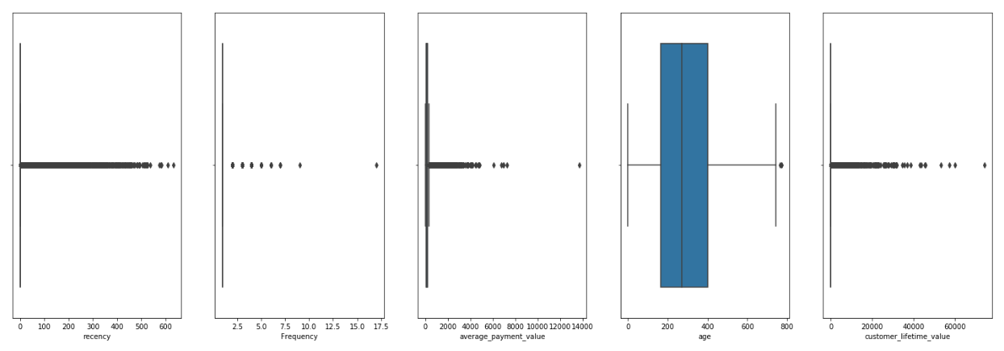
Data Analysis – Distribution of Data

Slide 5
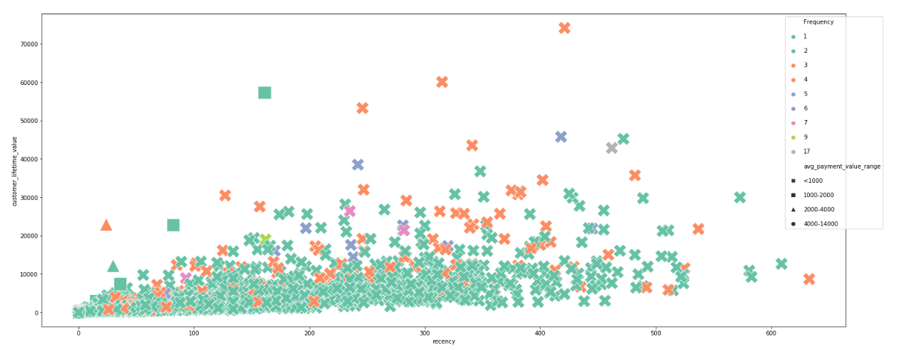
Data Analysis – RFM Analysis - CLV

Slide 6
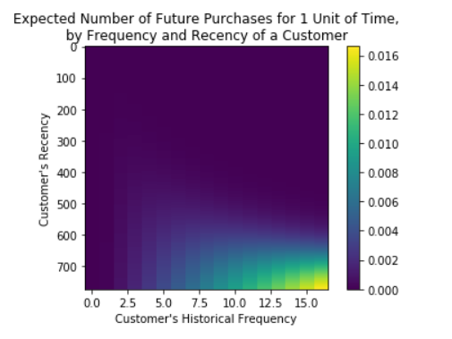
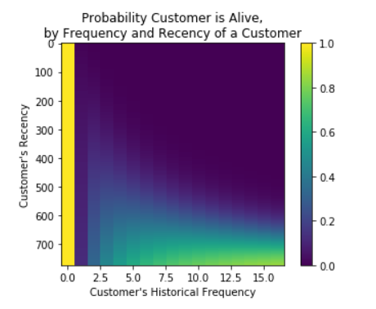
Data Analysis – RFM Analysis – BG/NBD Model

Slide 7
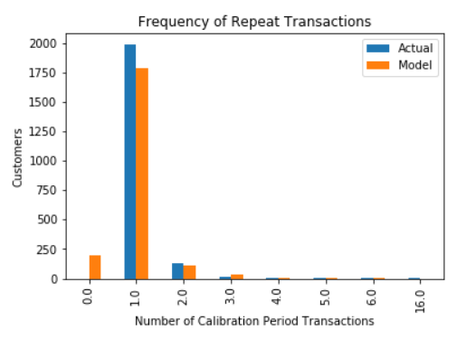
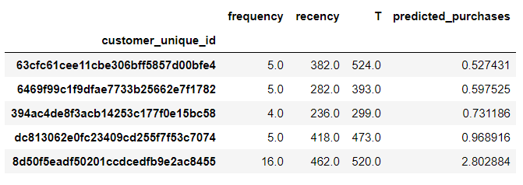
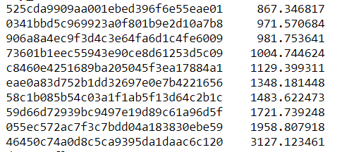
Data Analysis – RFM Analysis – Predictions
Top 5 customers and their predicted transactions over next 1 year
Top 10 Customers predicted profit for the next 12 months

